Slide 1
Oneida Nation Budget FY’2024
RaLinda Ninham-Lamberies, Assistant Chief Financial Officer

Slide 2
Purpose and intent of this presentation
To provide membership with an overall understanding of Oneida’s budget and budget process
Describe the elements contained in Oneida’s budget and why
Notes:
A budget is an estimate, based on all information known at the time, of revenues and expenditures. The important thing to remember is that the Nation does not have $529 million in our bank account waiting to be spent. The Nation receives revenues from Retail, Gaming, Grants, and other sources throughout the year. On September 30, the Nation has estimated we will have earned revenues of $474.3 Million, however, depending on what happens in the economy, in the world, and in the weather our estimates maybe too high or too low. Too low means we will end with a positive variance at year-end. Too high means we may have to curtail spending during the year so we don’t end the year in a deficit. Historically, the Nation has experienced a few year where we have ended in a deficit.

Slide 3
Founding Documents
Vision and Mission
Vision
A nation of strong families built on Tsi?Niyukwaliho TV and a strong economy
Mission Statement
To strengthen and protect our people, reclaim our land and enhance the environment by exercising our sovereignty

Slide 4
Core Values
The Good Mind as expressed by Onvyote?a·ká
Kahletsyalúsla (Gahlay-ja-loo-sla) The heart felt encouragement of the best in each of us
Kanolukhwásla (Gano-loo-kwa-sla) Compassion, caring, identity and joy of being
Ka?nikuhli·yO (Ga-nee-goo hlee yo) The openness of the good spirit and mind
Ka?tshatstVsla (Ga-stat-stuh-sla) The strength of belief and vision as a People
Kalihwi·yO (Galeeh-wee-yo) The use of the good words about ourselves, our Nation and our future
Twahwahtsílayv (Dwah wah jeeleye) All of us are Family
Yukwatsístayv (You-gwa-jees-stai) Our fire, our spirit within each one of us

Slide 5
Title 1. Government and Finances – Chapter 121
Oneida’s budget requirements and process are described in the Budget and Finances Law
The law sets forth the requirements to be followed when preparing the budget and establishes financial policies and procedures
Institutionalize best practices in financial management to guide decision makers in making informed decisions regarding the provision of services, implementation of business plans for enterprises, investments, and capital assets
Provide a long term financial prospective and strategic intent, linking budget allocations to organizational goals, as well as providing fiscal controls and accountability for results and outcomes

Slide 6
Title 1. Government and Finances – Chapter 121(Continued)
The Budget and Finances Law
Identify and communicate to the membership of the Nation spending decisions for the government function, grant obligations, enterprises, membership mandates, capital expenditures, technology projects, and capital improvement projects;
Establishes a framework for effective financial risk management
encourages participation by the Nation’s membership

Slide 7
Title 1. Government and Finances – Chapter 121(Continued)
Policy
It is the policy of the Nation to rely on balanced-based budgeting strategies, identifying proper authorities and ensuring compliance and enforcement.
The Nation shall use Generally Accepted Accounting Principles (GAAP), established by the Financial Accounting Standards Board, and the Governmental Accounting Standards Board (GASB) in accounting and reporting for the financial activities of the various entities of the Nation, unless they conflict with applicable legal requirements.

Slide 8
Broad Goals
The Oneida Business Committee is responsible for the development of the priorities, a strategic plan, or broad goals to assist in guiding the budget. The Broad Goals are currently the following:
Health and Safety
Housing
Food and Agriculture
Education
Culture and Language
Revenue Generation
Government Roles and Responsibilities

Slide 9
Budget Development
On August 16, 2023, the Oneida Business Committee approved the Fiscal Year 2024 budget to be sent to the General Tribal Council for approval.
Finance has created this presentation to inform General Tribal Council of the elements contained in the budget and why.

Slide 10
Sources - Understanding our sources of funding (P. 32 Packet)
Program Unit Earned income is specific to a program and the majority of that funding is restricted to the health center
Grants are funds from outside agencies and restricted to specific activities
Tribal allocations are non-cash items such as depreciation
Other sources of funding is mostly made up of prior year carry over and therefore is not a sustainable source of funding
Most of our funding is dependent on our Tribal Enterprises
Notes:
Resolutions include the activities specifically directed by GTC
Capital and debt is only our capital expenditures, we have no debt. These items include;
Gaming capital equipment. This is the amount specifically requested by gaming to reinvest in our equipment.
The Permanent Executive Contingency Fund is required to be set at a minimum of 1% according to the Budget and Finances Law. This fund is to be used by the Nation to prevent default on debt and to sustain operations during times of extreme financial distress.
Endowment are created according to the Oneida Endowments Law and contributions are set forth in the resolution.
Operational equipment is based on a list of equipment needs from the organization.
Building and maintenance set aside is

Slide 11
Allocations - Understanding where funds are allocated (P. 33 Packet)
Resolutions include the activities specifically directed by GTC (P. 42 Packet).
Capital and debt is only our capital expenditures, we have no debt. These items include the following (P. 43 Packet);
Gaming capital equipment. This is the amount specifically requested by gaming to reinvest in our equipment.
The Permanent Executive Contingency Fund is required to be set at a minimum of 1% according to the Budget and Finances Law. This fund is to be used by the Nation to prevent default on debt and to sustain operations during times of extreme financial distress.
Endowment are created according to the Oneida Endowments Law and contributions are set forth in the resolution.
Notes:
Resolutions include the activities specifically directed by GTC
Capital and debt is only our capital expenditures, we have no debt. These items include;
Gaming capital equipment. This is the amount specifically requested by gaming to reinvest in our equipment.
The Permanent Executive Contingency Fund is required to be set at a minimum of 1% according to the Budget and Finances Law. This fund is to be used by the Nation to prevent default on debt and to sustain operations during times of extreme financial distress.
Endowment are created according to the Oneida Endowments Law and contributions are set forth in the resolution.
Operational equipment is based on a list of equipment needs from the organization.
Building and maintenance set aside is

Slide 12
Allocations - Understanding where funds are allocated (Continued) (P. 33 Packet)
capital expenditures (P. 43 Packet);
Operational equipment is based on a list of equipment needs from the organization.
Building and maintenance set aside is utilized for the upkeep of approximately 80 buildings.
Technology projects include the hardware and software needed to meet our operational and regulatory requirements.
Capital Improvement Projects include new construction, furniture, fixtures, and equipment and improvements to existing buildings.
Land acquisition funds are based on the 2033 plan approved by GTC.
Notes:
Resolutions include the activities specifically directed by GTC
Capital and debt is only our capital expenditures, we have no debt. These items include;
Gaming capital equipment. This is the amount specifically requested by gaming to reinvest in our equipment.
The Permanent Executive Contingency Fund is required to be set at a minimum of 1% according to the Budget and Finances Law. This fund is to be used by the Nation to prevent default on debt and to sustain operations during times of extreme financial distress.
Endowment are created according to the Oneida Endowments Law and contributions are set forth in the resolution.
Operational equipment is based on a list of equipment needs from the organization.
Building and maintenance set aside is

Slide 13
Budget Overview (P. 34 Packet)
The total budget is comprised of $528,978,084 in sources and uses.
Tribal Enterprise
$340,678,931
Program Unit Earned Income
$41,496,094
Allocations for Tribal Operations
Resolutions
$50,473,872
Grants
$75,272,702
Capital & Debt
$73,963,048
Tribal Allocations
$16,886,847
Operations
$404,541,146
Other Sources
$54,643,510

Slide 14
Detailed Comparison

Slide 15
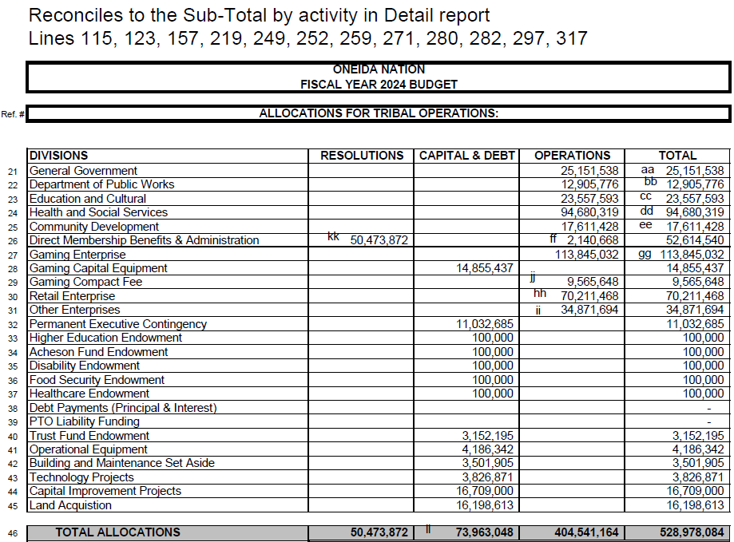
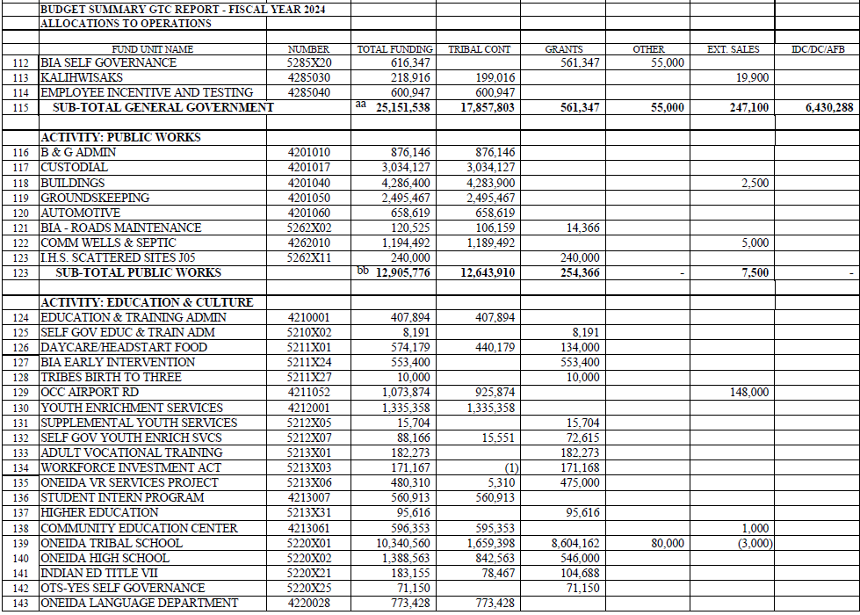
Detailed Comparison

Slide 16
Operational Costs General Government (PP. 35 - 36 Packet)
Purpose - Activities support the daily administration, fiscal, risk management, and government activities of the Oneida Nation.
Areas - A few of the specific fund units included in this category are Self-Funded Workers Compensation, Self-Funded Health Insurance, Accounting, Kalihwisaks, Legislative Operations Committee, Internal Audit, Digital Information Systems, and boards, committees, and commissions.
Foundation - These areas fulfill constitutional, legislative, regulatory, business and General Tribal Council requirements.
The activities of general government preserve, protect and exercise the sovereignty of the Oneida Nation.
Notes:
Resolutions include the activities specifically directed by GTC
Capital and debt is only our capital expenditures, we have no debt. These items include;
Gaming capital equipment. This is the amount specifically requested by gaming to reinvest in our equipment.
The Permanent Executive Contingency Fund is required to be set at a minimum of 1% according to the Budget and Finances Law. This fund is to be used by the Nation to prevent default on debt and to sustain operations during times of extreme financial distress.
Endowment are created according to the Oneida Endowments Law and contributions are set forth in the resolution.
Operational equipment is based on a list of equipment needs from the organization.
Building and maintenance set aside is

Slide 17
Operational Costs Public Works (P. 36 Packet)
Purpose - Plan, design, build, maintain, and operate the Oneida Nation’s public infrastructure.
Areas - Some of the fund units in this area include Automotive, Community Development, Custodial, Facilities, Grounds Keeping, Plumbing, Community Wells & Septic, and Utilities.
Foundation - The activities of this area provide healthy and safe buildings, grounds, vehicles, and infrastructure for community members, employees, and visitors and fulfill legal, regulatory, and operational responsibilities & requirements
Notes:
Resolutions include the activities specifically directed by GTC
Capital and debt is only our capital expenditures, we have no debt. These items include;
Gaming capital equipment. This is the amount specifically requested by gaming to reinvest in our equipment.
The Permanent Executive Contingency Fund is required to be set at a minimum of 1% according to the Budget and Finances Law. This fund is to be used by the Nation to prevent default on debt and to sustain operations during times of extreme financial distress.
Endowment are created according to the Oneida Endowments Law and contributions are set forth in the resolution.
Operational equipment is based on a list of equipment needs from the organization.
Building and maintenance set aside is

Slide 18
Operational Costs Education and Culture (PP. 36 - 37 Packet)
Purpose - Education and culture activities are activities to sustain, promote, and improve the quality, quantity, and availability of services for the Oneida Nation youth, Oneida Nation culture, and Oneida Nation arts.
Areas - Example of fund units included in this category are Daycare/Head start, Youth Enrichment Services, Higher Education, Oneida Tribal School, Oneida High School, Oneida Nation Museum, and the Library.
Foundation - Tsiˀ Niyukwalihó•tʌ – Our ways are our beliefs, our customs, and how we view the things (past, present, and future). This includes our history and things in our environment that make us distinct from others.
Activities in these areas maintain and interpret Oneida traditional teachings, customs and history. They preserve and protect the artifacts, collections, documents, audio and visual recordings including Oneida language material.
Oneida language is a vital part of our existence and is taught using different teaching methods to meet different learning styles.
Notes:
Resolutions include the activities specifically directed by GTC
Capital and debt is only our capital expenditures, we have no debt. These items include;
Gaming capital equipment. This is the amount specifically requested by gaming to reinvest in our equipment.
The Permanent Executive Contingency Fund is required to be set at a minimum of 1% according to the Budget and Finances Law. This fund is to be used by the Nation to prevent default on debt and to sustain operations during times of extreme financial distress.
Endowment are created according to the Oneida Endowments Law and contributions are set forth in the resolution.
Operational equipment is based on a list of equipment needs from the organization.
Building and maintenance set aside is

Slide 19
Operational Costs Health and Social Services (P. 37 - 39 Packet)
Purpose - Activities in this area include a wide variety of programs and services to support the overall wellbeing of the Oneida Community.
Areas - Specific fund units included in this category are Consolidated Health Service, Senior Citizens Center, Public Transit, Child Support Enforcement, and Oneida Family Recreation.
Foundation - These areas fulfill constitutional, legislative, regulatory, business and General Tribal Council requirements.
Notes:
Resolutions include the activities specifically directed by GTC
Capital and debt is only our capital expenditures, we have no debt. These items include;
Gaming capital equipment. This is the amount specifically requested by gaming to reinvest in our equipment.
The Permanent Executive Contingency Fund is required to be set at a minimum of 1% according to the Budget and Finances Law. This fund is to be used by the Nation to prevent default on debt and to sustain operations during times of extreme financial distress.
Endowment are created according to the Oneida Endowments Law and contributions are set forth in the resolution.
Operational equipment is based on a list of equipment needs from the organization.
Building and maintenance set aside is

Slide 20
Operational Costs Community Development (P. 39 - 40 Packet)
Purpose - Community Development includes a variety of government functions.
Areas - Specific fund units included in this category include the Oneida Police Department, Tsyuhekwa Life Sustenance, Food Distribution, Planning, Engineering, and Conservation.
Foundation - These areas keep Oneida engaged in our culture, provide for the community, fulfill grant requirements and preserve, protect and exercise the sovereignty of the Oneida Nation.
Notes:
Resolutions include the activities specifically directed by GTC
Capital and debt is only our capital expenditures, we have no debt. These items include;
Gaming capital equipment. This is the amount specifically requested by gaming to reinvest in our equipment.
The Permanent Executive Contingency Fund is required to be set at a minimum of 1% according to the Budget and Finances Law. This fund is to be used by the Nation to prevent default on debt and to sustain operations during times of extreme financial distress.
Endowment are created according to the Oneida Endowments Law and contributions are set forth in the resolution.
Operational equipment is based on a list of equipment needs from the organization.
Building and maintenance set aside is

Slide 21
Operational Costs Enterprise Operations (P. 40 – 41 Packet)
Purpose – Enterprise fund units are typically for-profit areas within the operations of the Tribe.
Areas - Specific fund units included in this category include Gaming, Retail, and other enterprises.
Foundation – Due to the Gaming Compact and other agreements with the State, Oneida has a regulatory advantage in providing specific goods and services. In the absence of a governmental tax base our enterprises account for a large portion of our funding.
Notes:
Resolutions include the activities specifically directed by GTC
Capital and debt is only our capital expenditures, we have no debt. These items include;
Gaming capital equipment. This is the amount specifically requested by gaming to reinvest in our equipment.
The Permanent Executive Contingency Fund is required to be set at a minimum of 1% according to the Budget and Finances Law. This fund is to be used by the Nation to prevent default on debt and to sustain operations during times of extreme financial distress.
Endowment are created according to the Oneida Endowments Law and contributions are set forth in the resolution.
Operational equipment is based on a list of equipment needs from the organization.
Building and maintenance set aside is

Slide 22
Administrative Costs and Other Operations (P. 41 Packet)
Purpose – Administrative costs and other operations account for the last two operational allocations
Areas – Administrative costs are for direct membership benefits and other operations is for our gaming compact fee.
Foundation – Memorandum of Agreement between Trust Enrollment and the Oneida Business Committee and the Gaming Compact account for these operational expenses.
Notes:
Resolutions include the activities specifically directed by GTC
Capital and debt is only our capital expenditures, we have no debt. These items include;
Gaming capital equipment. This is the amount specifically requested by gaming to reinvest in our equipment.
The Permanent Executive Contingency Fund is required to be set at a minimum of 1% according to the Budget and Finances Law. This fund is to be used by the Nation to prevent default on debt and to sustain operations during times of extreme financial distress.
Endowment are created according to the Oneida Endowments Law and contributions are set forth in the resolution.
Operational equipment is based on a list of equipment needs from the organization.
Building and maintenance set aside is

Slide 23
Balanced Budget
Sources $528,978,084
Allocations $528,978,084

Slide 24
Yaw^ko

